Slide 1

CSCI-3753: Operating Systems Spring 2021
Biljith Thadichi
Department of Computer Science University of Colorado Boulder
Slides based on presentation by Abigail Fernandes
CSCI 3753 Spring 2021

Slide 2

Week 9
> Bankers Algorithm
CSCI 3753 Spring 2021

Slide 3
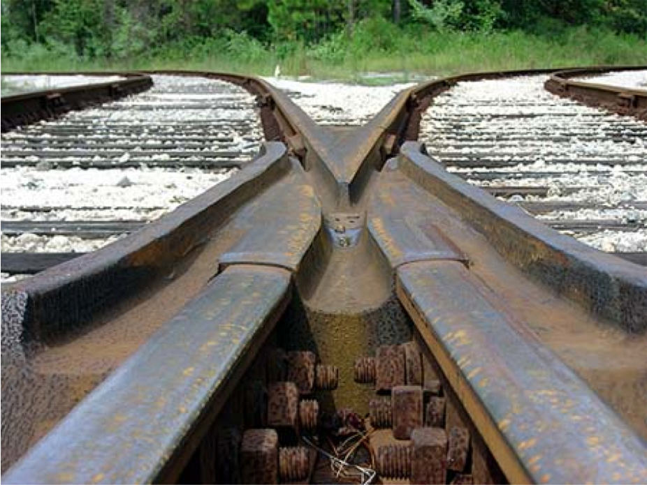
Deadlocks
Deadlocks exist amongst a set of processes if:
Every process is waiting for an event
This event can only be caused by another process in the set
Event can either be the acquisition or release of a resource
CSCI 3753 Spring 2021

Slide 4


Real world deadlocks?
Truck A has to wait for truck B to move
Not deadlocked
CSCI 3753 Spring 2021

Slide 5
Real world deadlocks?
GRIDLOCK
CSCI 3753 Spring 2021

Slide 6
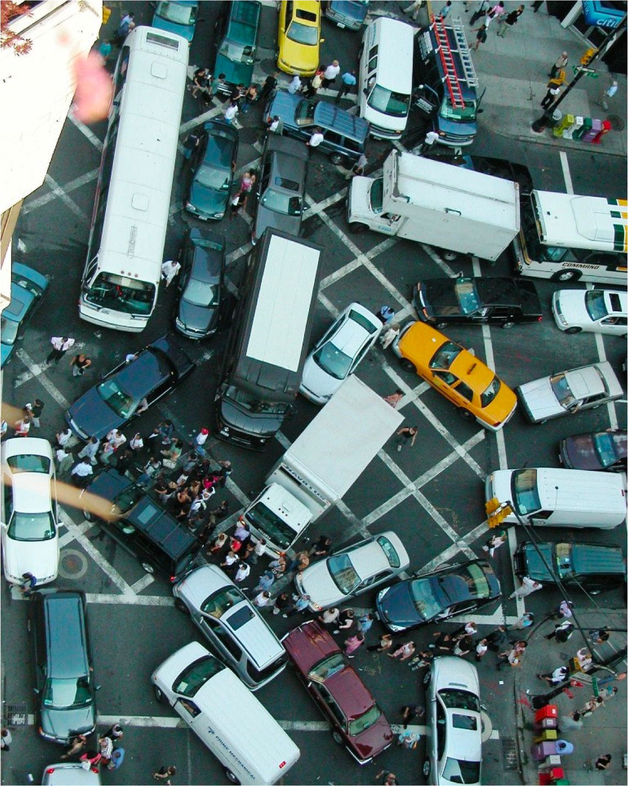
Thinking of moving to NYC?
CSCI 3753 Spring 2021

Slide 7
Deadlock avoidance strategy
CSCI 3753 Spring 2021

Slide 8
Deadlock Avoidance
If we have future information
Max resource requirement of each process before they execute
Can we guarantee that deadlocks will never occur?
Avoidance Approach:
Before granting resource, check if state is safe
If the state is safe ⇒ no deadlock!
CSCI 3753 Spring 2021

Slide 9
Safe State
A state is said to be safe, if it has a process sequence
{P₁, P₂,…, P_{n}}, such that for each P_{i},
the resources that P_{i} can still request can be satisfied by the currently available resources plus the resources held by all P_{j}, where j < i
State is safe because OS can definitely avoid deadlock
by blocking any new requests until safe order is executed
This avoids circular wait condition
Process waits until safe state is guaranteed
CSCI 3753 Spring 2021

Slide 10
Safe State Example
Suppose there are 12 tape drives
 | max need | current usage | could ask for
p0 | 10 | 5 | 5
p1 | 4 | 2 | 2
p2 | 9 | 2 | 7
3 drives remain
Current state is safe because a safe sequence exists: <p1,p0,p2>
p1 can complete with current resources p0 can complete with current+p1
p2 can complete with current +p1+p0
CSCI 3753 Spring 2021

Slide 11
Banker’s Algorithm- Introduction
Banker’s Algorithm also referred to as Deadlock avoidance algorithm
Developed by Dijkstra (Remember shortest path in a weighted graph)
CSCI 3753 Spring 2021

Slide 12
Banker’s Algorithm - Introduction
Suppose we know the “worst case” resource needs of processes in advance
A bit like knowing the credit limit on your credit cards. (This is why they call it the Banker’s Algorithm)
Observation: Suppose we just give some process ALL the resources it could need…
Then it will execute to completion.
After which it will give back the resources.
Like a bank: If Chase just hands you all the money your credit lines permit, at the end of the month, you’ll pay your entire bill, right?
CSCI 3753 Spring 2021

Slide 13
Banker’s Algorithm
So…
A process pre-declares its worst-case needs
Then it asks for what it “really” needs, a little at a time
The algorithm decides when to grant requests
It delays a request unless:
It can ﬁnd a sequence of processes…
…. such that it could grant their outstanding need…
… so they would terminate…
… letting it collect their resources…
… and in this way it can execute everything to completion!
CSCI 3753 Spring 2021

Slide 14
Banker’s Algorithm – Data Structures
n: integer m: integer
# of processes # of resources
available[1..m] - available[i] is # of available resources of type i
max[1..n, 1..m] - max demand of each Pi for each Ri. Max[i][j] = k means that Pi can request at most k instances of Rj
CSCI 3753 Spring 2021

Slide 15
Banker’s Algorithm – Data Structures
allocation[1..n, 1..m] – allocation[i][j] is the current allocation of resource Rj to Pi
need[1..n, 1..m] - max # resource Rj that Pi may still request
need[i,j] = max[i,j] – allocation[i, j]
let request[i] be vector of # of resource Rj Process Pi wants
CSCI 3753 Spring 2021

Slide 16
Banker’s Algorithm – Data Structures
Resources
Column j
 | 1
 | 7
 | 12
8 0 | 2 | 17 0 | 1
 | 0
 | 4
 | 0
 | 1
Processes
Allocation[i,j] = current allocation of resource j that has been
allocated to process i
Row i
CSCI 3753 Spring 2021

Slide 17
Banker’s Algorithm Terminology
Let X and Y be two vectors (think 1D - arrays)
Then we say X ≤ Y if and only if X[i] ≤ Y[i] for all i.
Example:
then V2 ≤ V1, but V3 ≤ V1, i.e. V3 is not less than or equal to V1
1
7
3
2
0
3
2
1
0
10
2
1
V1 =
V2 =
V3 =
CSCI 3753 Spring 2021

Slide 18
Basic Algorithm
If request[i] > need[i] then
error (asked for too much)
If request[i] > available[i] then
wait (can’t supply it now)
Resources are available to satisfy the request
Let’s assume that we satisfy the request. Then we would have:
available = available - request[i] allocation[i] = allocation [i] + request[i] need[i] = need [i] - request [i]
Now, check if this would leave us in a safe state: if yes, grant the request,
if no, then leave the state as is and cause process to wait.
CSCI 3753 Spring 2021

Slide 19

Safety Check
work[1..m] = available /* how many resources are available */ finish[1..n] = false (for all i) /* none finished yet */
Step 1: Find an i such that finish[i]=false and need[i] <= work
/* find a proc that can complete its request now */ if no such i exists, go to step 3 /* we’re done */
Step 2: Found an i:
finish [i] = true /* done with this process */ work = work + allocation [i]
/* assume this process were to finish, and its
allocation goes back to the available list */
go to step 1
Step 3: If finish[i] = true for all i, the system is safe.
Else Not
CSCI 3753 Spring 2021

Slide 20
Your turn now! Solve an Example
CSCI 3753 Spring 2021

Slide 21
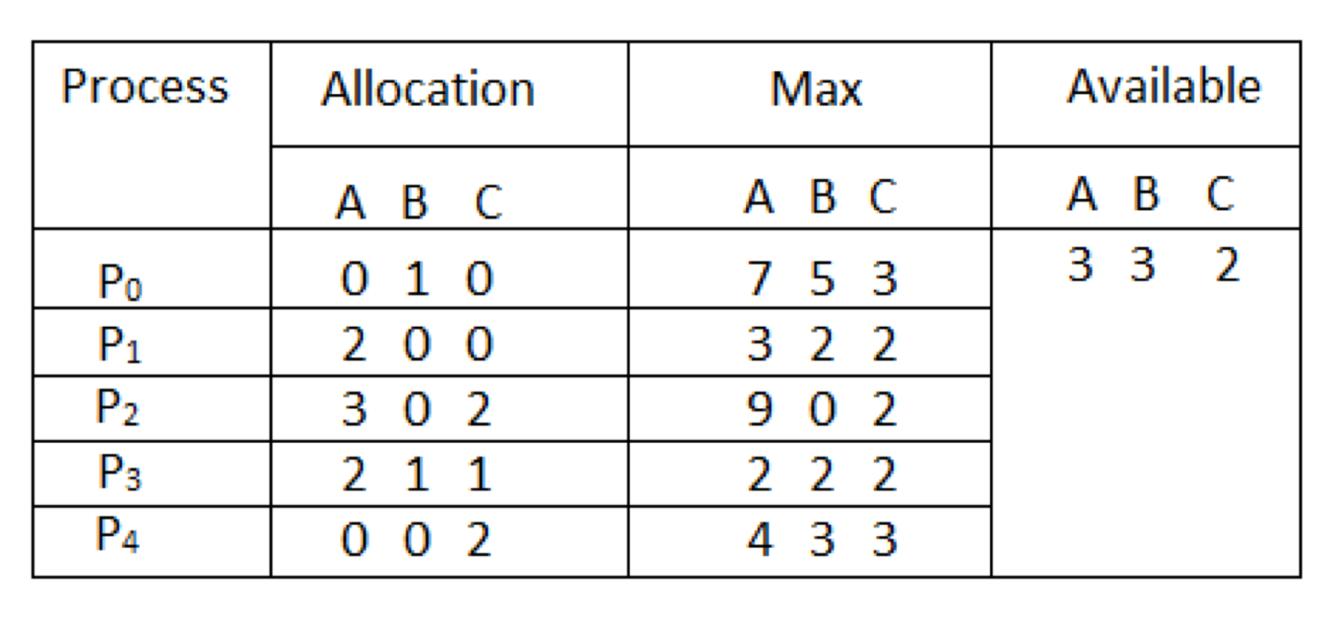
Banker’s Algorithm Example
Considering a system with five processes P₀ through P₄ and three resources of type A, B, C. Resource type A has 10 instances, B has 5 instances and type C has 7 instances. Suppose at time t₀ following snapshot of the system has been taken:
CSCI 3753 Spring 2021

Slide 22
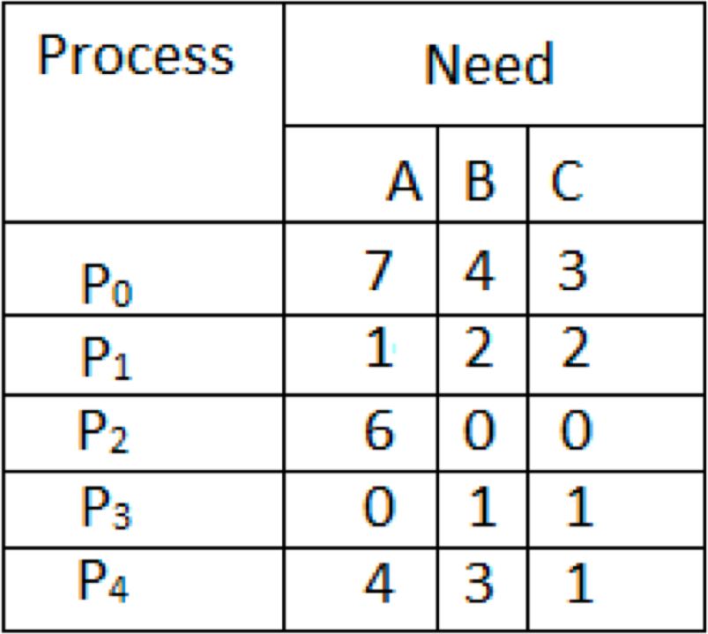
Banker’s Algorithm Example
Question1. What will be the content of the Need matrix?
Recall: Need [i, j] = Max [i, j] – Allocation [i, j]

Slide 23
Banker’s Algorithm Example
Question2. Is the system in a safe state? If Yes, then what is the safe sequence?
CSCI 3753 Spring 2021

Slide 24
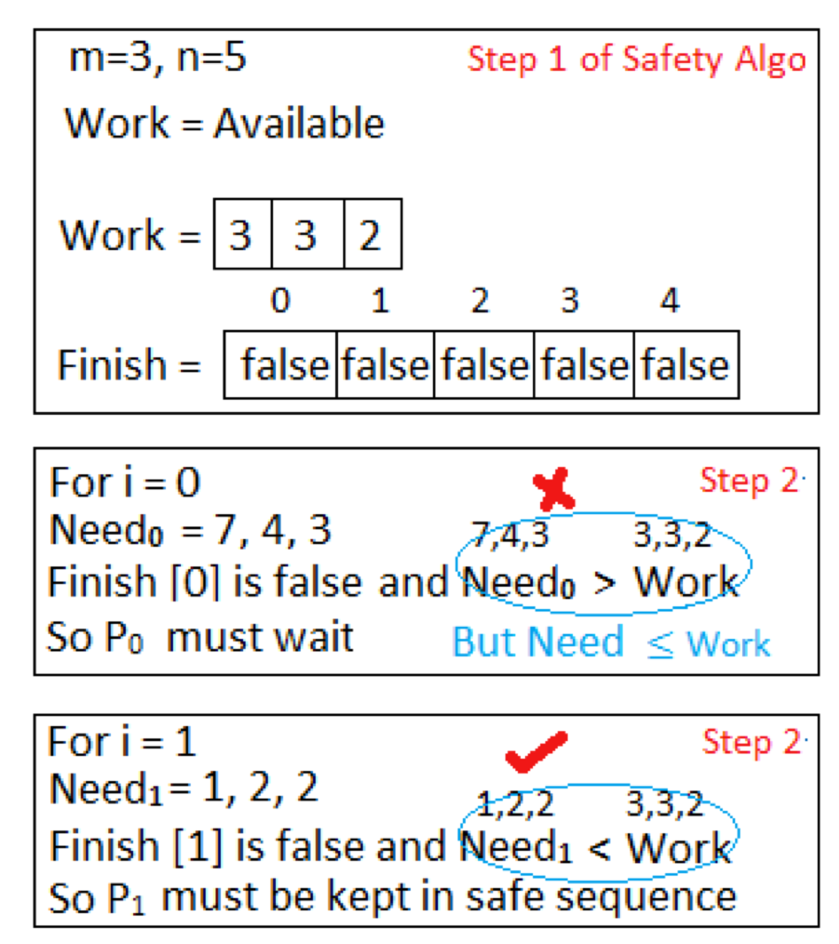
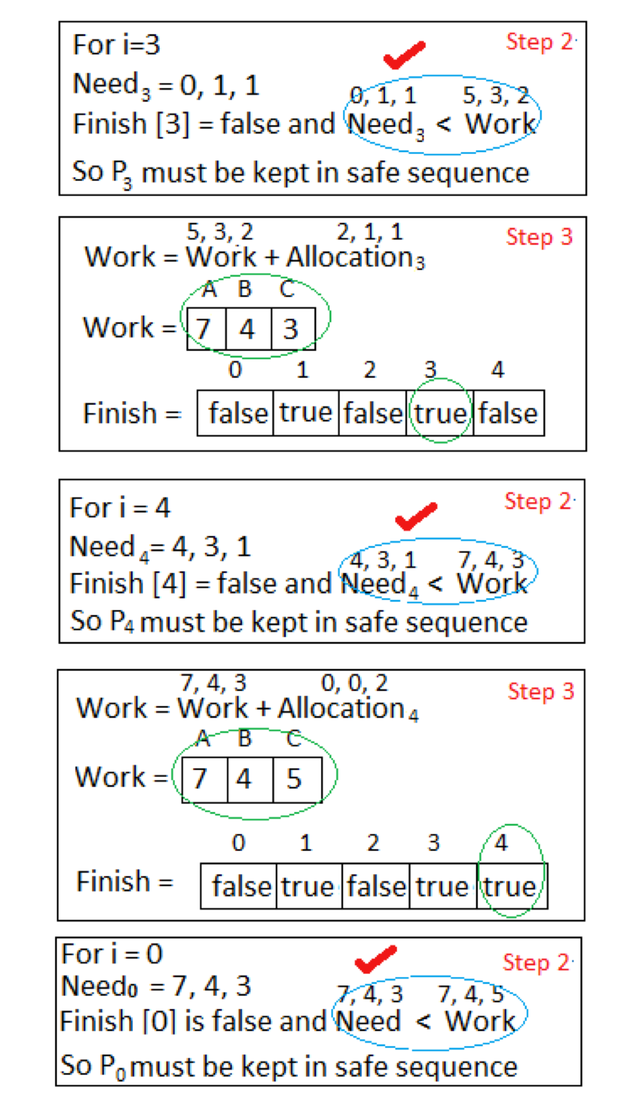
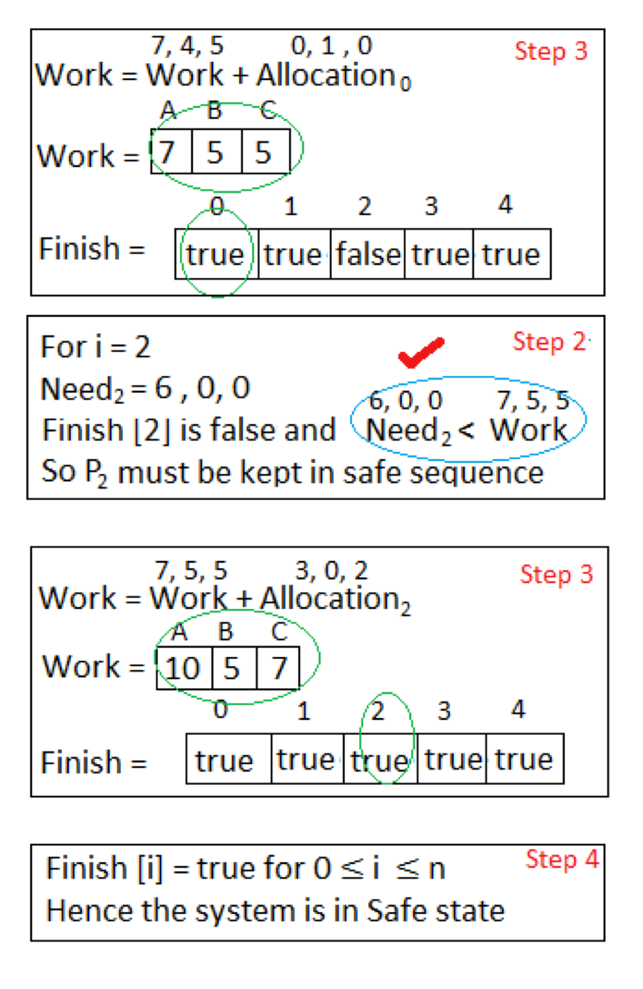
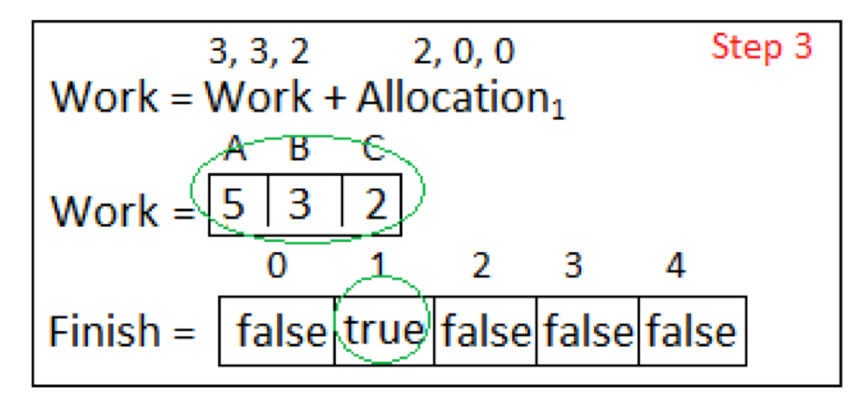
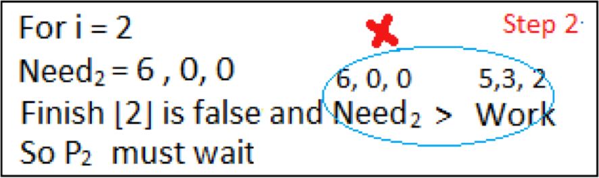
Banker’s Algorithm Example

Slide 25
Banker’s Algorithm Example
Question2. Is the system in a safe state? If Yes, then what is the safe sequence?
Yes, <P1, P3, P4, P0, P2> is a safe sequence
CSCI 3753 Spring 2021

Slide 26

Week 9 – Checklist
Complete this week’s quiz
Work on PS3. Solving the PS should be a good revision for the Midterm
Solve an additional example on Banker’s algorithm
CSCI 3753 Spring 2021

